Slide 1

leading in the Never Normal
Navigating
DISRUPTION & PARADOX

Slide 2

Volatility. Nature, dynamics and speed of change, and the change catalysts.
Uncertainty. Lack predictability, prospect of surprise or ambush, awareness & understanding of facts & feelings.
Complexity. Multiplex of forces and issues, no clear cause -and-effect chain with confusion around situation or project.
Ambiguity. Hazy reality, high potential for misunderstanding and cause-and-effect confusion.
Disruptive. Radical change in an existing industry, market or process. Internal & external.
Asynchronous. All at once, constantly.
Headwinds of V.U.C.A.D.A.

Slide 3

A paradox has multiple realities that co-exist.
By definition, this creates tension.
Both are right and true. It’s a complex leadership ask.
Purpose
Performance
Internal Focus
External Perspective
Perform
Transform
Be Optimistic
Be Realistic
Growth
Profit
Exploit the Present
Explore the Future
Autonomy
Responsibility
Be Lean
Be Ready to Scale
Caring for Others
Caring for Yourself
Set Direction
Enable Democracy
Embracing Change
Preserving Stability
Regional/Global
Local
Having Expectations
Extending Grace
Focus on Consumer
Focus on Transforming
Standardise
Customise
Obey regulation
Challenge Status Quo
Execute
Innovate
Integrate
Accelerate
What are some of the Paradoxes you face?

Slide 4

You will go crazy
trying to solve
a paradox
So, stop.
Get comfortable with being uncomfortable
– there is no recipe.
Focus on
creating your omelet.

Slide 5
We are comfortable to solve
linear opportunities & challenges.
When we try and solve a paradox…
PASSIVE ACCEPTANCE
PASSIVE RESISTANCE
PASSIVE
AGGRESSIVE
AVOID, STUCK, TOXIC
CONFLICT

Slide 6

When we identify
a Paradox,
we need
a mindset shift.
X
Y
from either/or
to both/and

Slide 7
Passionate
Detachment
Holding commitment to people, purpose and performance
whilst bringing perspective to navigate better outcomes
in the paradoxical never normal.

Slide 8
We don’t solve a paradox.
We navigate it. Iteratively.
Healthy tension is the birthplace of growth, innovation and progress.

Slide 9
Passionate
Detachment
Unhook from emotional hijacks with Emotional Agility
Move between open and focus with Cognitive Agility
Nurture agility with Systems Thinking
Role model Healthy Resilience for sustainable performance and fulfilment.

Slide 10
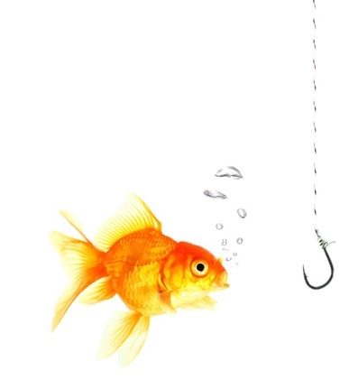
Emotional Agility
Our ability to experience our thoughts and feelings,
positive and negative, and “show up” as the best
version of ourselves more often
UNHOOK from the emotional hijack sabotaging you.
Be curious about emotions as data not fact.
“I am angry.”
“I am scared.”
“I am frustrated” Emotion becomes my identity
“I experiencing anger.”
“I am experiencing fear.”
“I am experiencing frustration” Emotion is used as a data point

Slide 11
Leadership Equation
P = C x M²
Performance =
Capability x
Mindset²
Values, Preferences, Experience, Beliefs & Perceptions

Slide 12
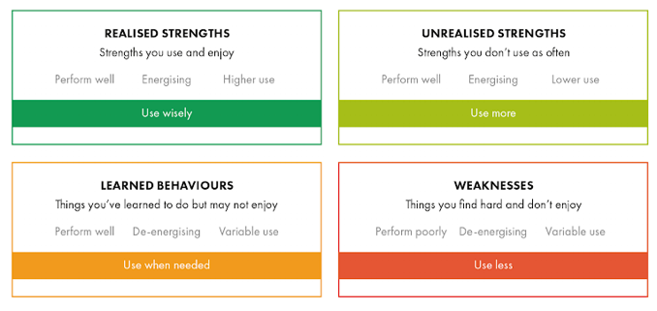

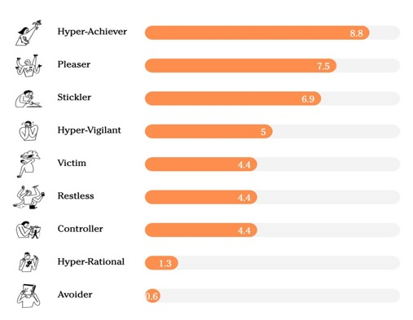

Self Awareness
Summary of Strengths and sabs and

Slide 13

Power of PAUSE
30-minute leadership reflection time each week.
Pick a couple of questions that feel relevant to explore….
What did I lead well this week? What was the learning from it?
What does success look like for me next week?
What am I feeling grateful for? In my team? My strengths? In my relationships? In my life?
When did my saboteurs get triggered? How did they show up in my behaviour? How did it feel? How can I manage this trigger differently. next time?
Which relationships need a health check on the trust bank account? How will I strengthen the trust bank balance?
What was my Empowering high and low point?
What’s happening next week I can think and plan for, so that I bring my best self? Plan to Influence? Plan to Align?
What strengths can I use more explicitly and intentionally?
YOUR LEADERSHIP ACCELERATOR

Slide 14


COGNITIVE AGILITY
What is needed of me right now? The leadership ask?
Our ability to move easily between thinking modes to bring what is most needed to the situation.
Divergent, convergent, clarity and compliance or innovate and disrupt.
And put the speed into the agility to respond, to pivot, to reframe.
CONVERGENT:
Focus, decisive, directive
DIVERGENT:
Open, expansive, coaching

Slide 15
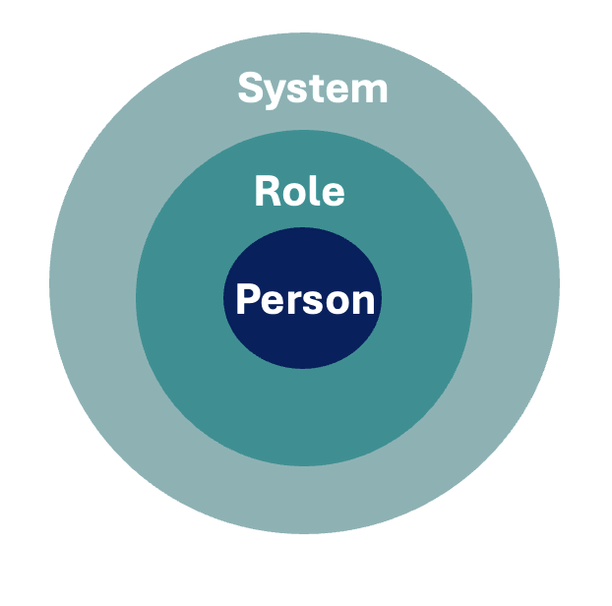
Foundation of Self to System

Slide 16

SYSTEMS THINKING
Proactive management of interdependencies, intended and unintended consequences
Anticipatory and reactive strategic stakeholder management
Navigating unhealthy back to healthy tension with agility
Notes:
(Charline Li, The Disruption Mindset)

Slide 17

HEALTHY RESILIENCE
“Resilience is our capacity to remain flexible in our thoughts, feelings and behaviours when faced by extended periods of adversity, so that we emerge stronger, wiser, and more able.”
“Resilience is about how we recharge,
not how we endure.”

Slide 18
HEALTHY RESILIENCE
Unhealthy Resilience
Brittle, enduring, pushing yourself harder and edging you or others closer to breaking point
Healthy Resilience
Setting boundaries to stay adaptable, able to learn, grow and bounce back stronger from adversity
“Resilience is about how we recharge,
not how we endure.”

Slide 19
P.A.U.S.E. for healthy resilience
Purpose
I feel a sense of purpose in my day to day which gives me perspective and better enables me to live and lead with my values aligned to my actions most of the time.
Attitude
I manage my mindset through self-awareness, curiosity and empathy. I practice emotional agility to unhook from an emotional hijack and choose how I respond to my circumstances, bringing a growth mindset, building on my strengths and with awareness of my behaviours that can undermine me.
Understand
What’s needed of me in this moment? With cognitive agility I am able to reflect and separate feelings from fact. I listen to understand (not just to respond). I am able to focus on what is in my control or that I can influence and accept and adapt to what I cannot control.
Support
I have a safe and trusted person(s) in my life, who has my best interests at heart, delivers a tough message with care, from whom I draw strength and with whom I feel safe to step back and explore challenges. I have a robust network of trusted relationship which support my success.
Energy
I actively manage my mental & physical return on energy. I understand what fuels my energy, and what drains it. I set boundaries and prioritize time and space to recharge and protect my wellbeing.
Notes:
In 1989 a developmental psychologist Professor Emmy Werner
published the results of a thirty-two-year longitudinal project which tracked everyone born on the island of Kawai in 1955, part of the Hawaiian archipelago. Her sole purpose was to better understand why some people are more resilient than others and what are the drivers of that resilience. There were 5 significant factors of resilience.
I applied the insights from the above study to design how to create and maintain a state of healthy resilience. PAUSE for Healthy Resilience.

Slide 20
Passionate
Detachment
Holding commitment to people, purpose and performance
whilst bringing perspective to navigate better outcomes
in the paradoxical never normal.

Slide 21
Thank you

