Slide 1

Cognitive Agility
Ability to move between openness and focus

Slide 2

Passionate
Detachment
Holding commitment to people, purpose and performance
whilst bringing perspective to navigate better outcomes
in the paradoxical never normal.

Slide 3
Passionate
Detachment
Emotional Agility
Cognitive Agility
Systems Thinking
Healthy Resilience

Slide 4
Cognitive Agility
Ability to move between openness and focus
What is needed of me right now? The leadership ask?
Divergent: Open, expansive, coaching
Convergent: Focus, decisive, directive

Slide 5

CONSCIOUS CURIOSITY.
What is needed of me as a leader right now?
LEADs WITH
COACHING
PATERNAL >
PASSIVE AGGRESSIVE > PATRONISING
EXPANSIVE innovative
THINKING PARTNER
Cognitive Agility
PATERNAL >
DOMINANT > AGRESSIVE
COVERGENT, DIRECTION
THINKING PARTNER
LEADs WITH
Direction
Emotional
Agility
FIXED/HABITUAL
Mindset
GROWTH/EXPANSIVE
Mindset

Slide 6

Creating the space for greatness…
“People think focus means saying yes to the thing you’ve got to focus on...it means saying no to the hundred other good ideas that there are. You must pick carefully.” Steve Jobs
Prioritisation is a list of everything you can do. In some order of importance. The 1st step.
Focus is deciding what to stop to create the space and conviction to succeed and achieve. The hard step we avoid.
0

Slide 7




Speed with agility to respond, to pivot, to reframe
Put the PUSH & PACE into the PIVOT
How you anticipate and respond to change.
Law of diminishing returns
Productive
Phase
Diminishing
Returns
Negative
Returns
Output
Input

Slide 8

What sort of decision is being ask of me?
A locked door.
There is no going back.
A revolving door.
Test, learn, pivot.

Slide 9
When there is so much overwhelm in the Never Normal….
How do we focus? How do we unpack the washing machine in our head?

Slide 10
MIND MAP IT
Supports natural way of “divergent” thinking and leverages “collective intelligence”
MIND MAP
Project Zinc
  Research & content development
Economy / budgets
Socio political distractions
  Team & 1:1 demands
0
  exhaustion
  Coach
  availability
Clients changing companies
  Team time
Volatile
Quality control of delivery, updating materials, client service
Asynchronous
Responding
To new briefs
  US cohort
  Other programs
  Number of
  participants
  Training coaches
Uncertain
Disruptive
Budget
  Maternity leave
  Sick leave
Complex
Choice of times, topics
Ambiguous
  timeframe
Unpack the washing machine in your head.
Think / Dream of every possibility
Map the reality to get aligned as a team.
  scope
Design for flexibility
  internal learning offering

Slide 11

Headwinds of V.U.C.A.D.A.
Volatility Nature, dynamics and speed of change, and the change catalysts.
Uncertainty Lack predictability, prospect of surprise or ambush, awareness & understanding of facts & feelings.
Complexity Multiplex of forces and issues, no clear cause- and-effect chain with confusion around situation or project.
Ambiguity Hazy reality, high potential for misunderstanding and cause- and-effect confusion.
Disruptive Radical change in an existing industry, market or process through innovation.
Asynchronous All at once, constantly.

Slide 12

Leading in
VUCADA
“… I was always looking to the future with an eye to controlling what I could control, influencing what I didn’t control and preparing for what I couldn’t control”
General G.W.Casey Jnr. US Army, Distinguished Snr Lecturer,
Cornell University School of Management
Notes:
The rest of the session is to give a couple of tools to help you with Steps 3 and 4 – Walk Your Why and Moving On
three Tools/concepts – to help navigate Outer and Inner worlds.
1. Circles of control
2. Focus and prioritization
3. Managing expectations

Slide 13
Control what’s
IN MY CONTROL
Influence what
I DON’T CONTROL
Prepare or
let go of what
I CAN’T CONTROL

Slide 14





Managing Expectations & boundaries
with the Strategic No⁵
It is Not Adding Value to the strategy, as we have agreed.
Yes, it’s a good idea, but its
Not For Now, let’s revisit in Q4…
NO⁵
Yes, it needs to be done, but it’s
Not For Me, let me help you find the right person
Yes, its important, but it’s Not In My Control. Let’s think about who is in control, and how to influence them…
Yes, this is important to do, but Not Without Resources/Time/Tradeoffs

Slide 15

How to be a Great Thinking Partner
Ask for help to think… help someone to think.
Bring an open curious mindset & questions.
Always use the W.H.A.T.^{Questions}
When you are the thinking partner, it’s not your answer they need. It’s a great question to unlock their solution.
Listen to understand NOT respond. Play back what you hear. Challenge to build, not destroy.
Ban the Low Why? “Why didn't you call sooner?” It begs defensiveness from them and looks to the past. The High Why? Brings purpose and inspiration. Why is this important to you and your future?
in order, written down, in full. This frames the thinking, drives ownership and ensures its not just nice chat.
What do I / we want?
How will I / we achieve it?
Accountability for Action?
Timeframe?
1
Describe all surface symptoms
2
Peel back layers of underlying conditions
3
Get to the root cause of what you want to change. What will shift the needle?

Slide 16
Open Questions
to help peel the onion & get to the root cause of what you really want to acheive.
What do you want? What does success look like?
Visualise your successful outcome. Describe it.
What is the reality? What are all the “symptoms” around this topic?
What are any assumptions you might be making?
What are the barriers to success? What are the opportunities?
What is the reality for all the stakeholders involved? Map them and their needs..
Walking in the other person’s shoes, what would they think, feel or do in response to your ambition?
What’s the benefit of doing this? What is the impact of doing nothing?
If you knew you could not fail, what would you do? What does your intuition tell you?
Say what you feel out loud... if someone else said this, what advice would you give them?
What will be different in the future when you have achieved/done this?
What motivates you to do / want this?
What would the person you most admire think of this?
What words would you use to explain this to a 10-year-old?

Slide 17


The Art of Influence
What makes you credible to the audience?
What is your reputation, posture, attitude telling the other person?
Do you have new / relevant data, research or experience?
Do you have conviction which is clear and compelling - a vision for success?
4BC, the Book of Rhetoric
Ethos / Credibility
What is the voice in their head saying? What are they worrying about?
Acknowledge and address the concern with empathy to defuse the worry and enable them to focus on you and. what you have to say.
How can you make them feel understood and acknowledged?
What are the facts? Now they are as open as you can hope to listen to your needs or ambitions …. Lay out what you want in clear simple messages.
Kairos
Know your
audience & goal,
& when to best achieve it.
WHAT Qs
Pathos / Empathy
Logos / Logic
Notes:
Add in help model, fear model and vulnerability disucssion

Slide 18
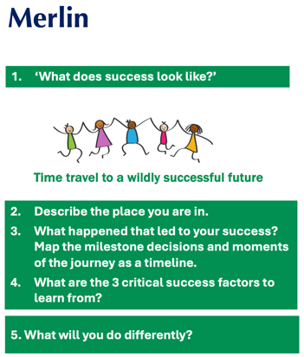
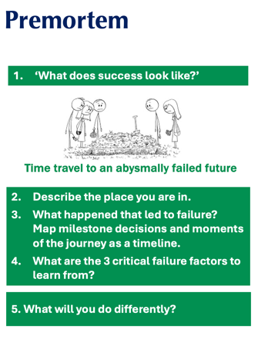
The learning space → harness the power of hindsight & insight!

Slide 19
Post Mortem
A.A.R. After Action Review
What was supposed to happen?
What was the reality?
What went well?
What did not go well?
What will we change for next time?

Slide 20

Walk towards the best version of me
Life’s line of choice.
Beware of the Reasonable reasons to walk away …

