Slide 1
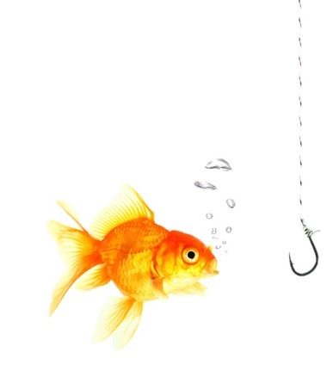
Emotional Agility

Slide 2

Passionate
Detachment
Holding commitment to people, purpose and performance
whilst bringing perspective to navigate better outcomes
in the paradoxical never normal.

Slide 3
We navigate a Paradox.
With iterative solutions, we seek the growth from the tension, responding to outcomes and changing context with curiosity and agility.
When we identify a Paradox, we must engage a mindset shift.
X
Y
from either/or to both/and

Slide 4
The Leadership Equation
P = C x M²
^{Saboteurs}
Performance =
Capability x
Mindset²
Values, Preferences, Experience, Beliefs & Perceptions

Slide 5
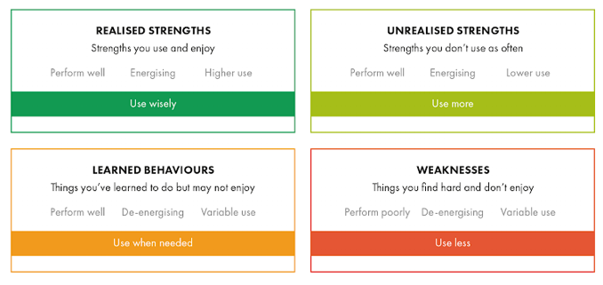

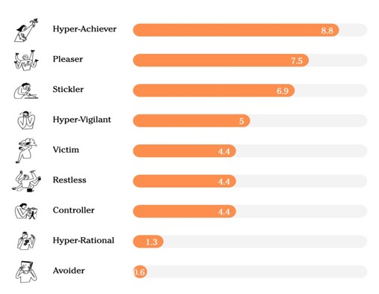

Self Awareness
Summary of Strengths and sabs and
www.positiveintelligence.com

Slide 6
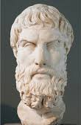
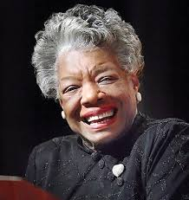
"It's not what happens to you,
but how you react to it that matters"
Epictetus, Stoic philosopher
People will forget what you said, people will forget what you did, but people will never forget how you made them feel”
Maya Angelou

Slide 7
Emotional Agility
Our ability to experience thoughts
and feelings - positive and negative -
and “show up” as the best
version of ourselves more often

Slide 8
Emotional Agility
Our ability to experience our thoughts and feelings,
positive and negative, and “show up” as the best
version of ourselves more often
UNHOOK from the emotional hijack sabotaging you.
Be curious about emotions as data not fact.
“I am angry.”
“I am scared.”
“I am frustrated” Emotion becomes my identity
“I experiencing anger.”
“I am experiencing fear.”
“I am experiencing frustration” Emotion is used as a data point
How do I want to show up right now?

Slide 9



When you’re hooked…which bait do you take?
What do you do with your emotions?
ALL 3 will dramatically diminish:
Well-being * Communication * Empathy * IQ
* Relationship quality * Problem solving * Goal attainment
The Bottler
The Exploder
The Brooder
Push away or suppress negative emotion to avoid discomfort of feeling them; perceives emotion as a sign of weakness.
Bottled emotions surface in unintended, irrational ways.
My emotions become my identity.
I respond as the emotion.
I am hijacked in the moment by my emotions and show up as my monkey!!
Stuck in negative feelings.
Relives & ruminates over the negative feelings. Focus on internal chatter and tends to personalize it.
Brooding up emotions makes them more powerful, personal and catastrophic.

Slide 10
Still not convinced… Listen to a G.O.A.T.
ROGER FEDERER

Slide 11







By breathing down into the gut, we trigger a brain hit of serotonin, our calming drug
AND BREATHE…
Imagine you are sitting in a meeting and are triggered…
Feet anchored on the ground
Sit upright, straight back
IN & OUT THROUGH NOSE
Take 3 long deep breathes, pushing it down into your gut.

Slide 12

micro-mindfulness
With the lightest touch rub your thumb and
forefinger prints together…
PQ Reps

Slide 13
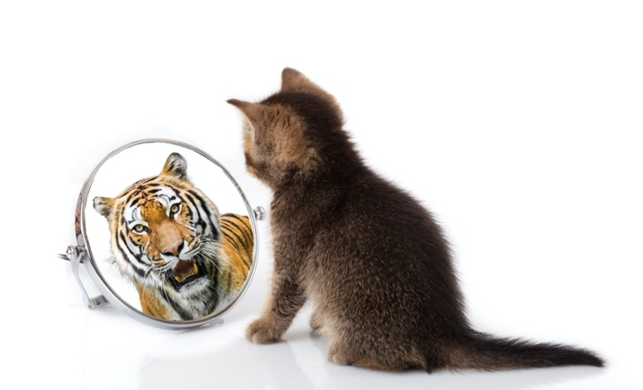
Power of Pause
30-minute leadership reflection time / week
Pick a couple of questions that feel relevant to explore….
What did I lead well this week? What went less well or not as expected. What was the learning from all?
What does success look like for me next week?
What am I feeling grateful for? In my team? My strengths? In my relationships? In my life?
When did my saboteurs get triggered? How did they show up in my behaviour? How did it feel? How can I manage this trigger differently next time?
Which relationships need a health check on the trust bank account? How will I strengthen the trust bank balance?
What was my Empowering high and low point?
What’s happening next week I can think and plan for, so that I bring my best self? Plan to Influence? Plan to Align?
What strengths can I use more explicitly and with intention?
YOUR LEADERSHIP ACCELERATOR

Slide 14
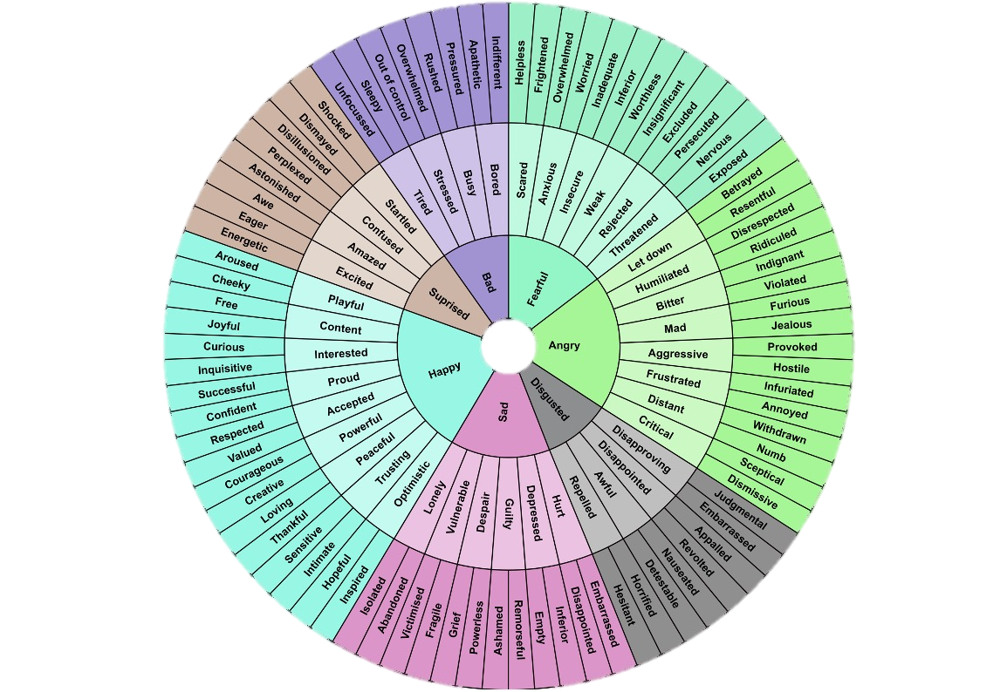
Show Up. Name the emotion.
Unhook. Explore emotion with perspective, as data not fact.
How do I want to show up right now?
What do I learn with new perspective?
What’s my reality? What’s important
for my values, My personal brand?
What saboteur is hijacking me?
If I walk in their shoes, what are they
feeling? What is their intent? What is my intent?
What’s the bigger picture?
What’s the importance of this relationship to me and
my success or failure?
What do I want? What do they want?
What do I need? What do they need?
Exercise:
Pick a relationship or situation about which you are emotionally hijacked.
What are the feelings you are experiencing?
What do you learn when you explore them as data?

Slide 15








  Reframe: You are in control of your thoughts.
  Emotionally High-Jacked
  Stuck in Negativity Loops
  Undermined by Limiting Beliefs
Catastrophic fantasies ...
Thoughts
Behavioral loops
create response patterns which validate the belief.
Feelings
Behaviours

Slide 16
Reframe Perceptions
Step 1
What I Dislike …
Step 2
Benefit to them is…
Step 3
Opposite of
What I Dislike…
Step 4
Disadvantages of Opposite…
Step 1
Step 2
Step 3
Step 4
Describe the attitudes / behaviours that you dislike about this person.
What might be the benefits /desirable aspects of these behaviours?
What are the opposite traits of these attitudes / behaviours you disklike in Step 1?
What are the
non-desirable aspects of these behaviours in Step 3?
I manage risk well, I’m being the protector.
Feel clever, pointing out little things others miss. I feel less insecure.
Never aggressive, I just don’t make it easy.
Avoid where I don’t want to go.
I’m the realist. I feel needed, like have to to play this role.
I feel in control of status quo.
Optimist, inspirer
Creator, opportunist, innovator, risk taker
See’s big picture, not sweat the small stuff
Open, Direct, candid, transparent, authentic.
Agile to iterate, learn and fast to adapt.
Brings energy
Change agent
Over promise, pleaser, says yes to eveything
Overwhelm others
Dreamer, not focused, not in the detail
Too transparent, vulnerable
Not in control
Feels risky
Not consistent, chaotic
Persistently negative
Cup half empty
Focus on small frustrating derail, misses the point
Passive Aggressive
Avoidant
Energy draining
Change resistant
This is how you experience them.
Your reality.
Is it possible this is how they see themself?
Their reality.
Is it possible this is how you see yourself?
Your reality.
Is it possible this is how they experience you? Their reality
“Maybe they are not difficult, just different.”

Slide 17


The Learning Space
Feels frustrating, scary, uncomfortable, awkward; Can trigger fight or flight ‘give up’ ‘avoid’ ‘question it’ → That is the feeling of learning & changing.
Not knowing
Knowing
The longer you can tolerate being in the learning space,
the greater you build your resilience and success.
Reframe to feel excited in the learning space. Get comfortable with being uncomfortable.
Notes:
New conceptd, toosl

Slide 18

Walk towards the best version of me
Life’s line of choice.
BEWARE
Reasonable reasons to walk away …

